Slide 1
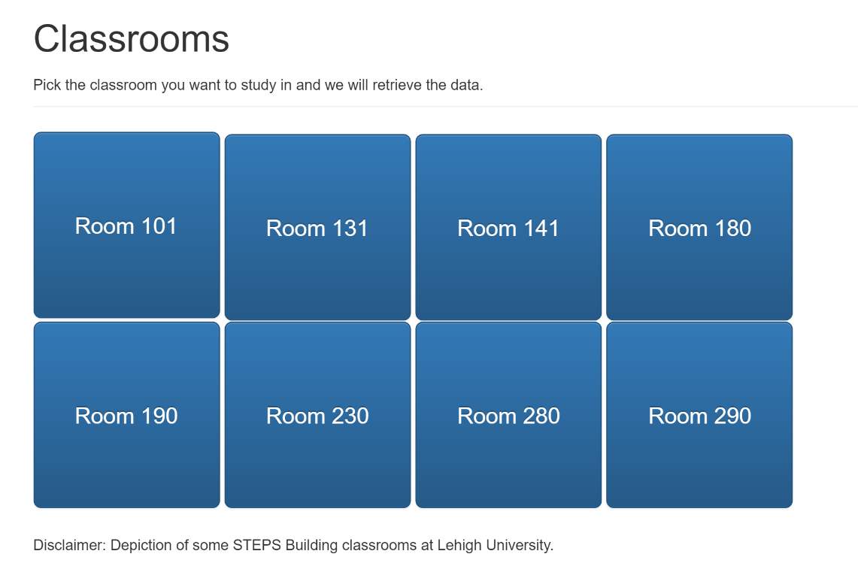
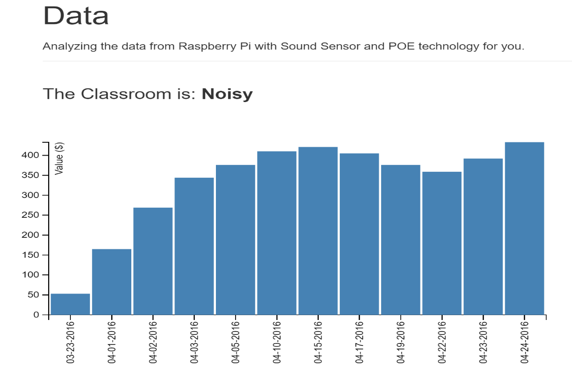



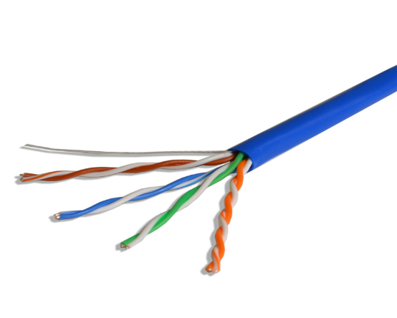

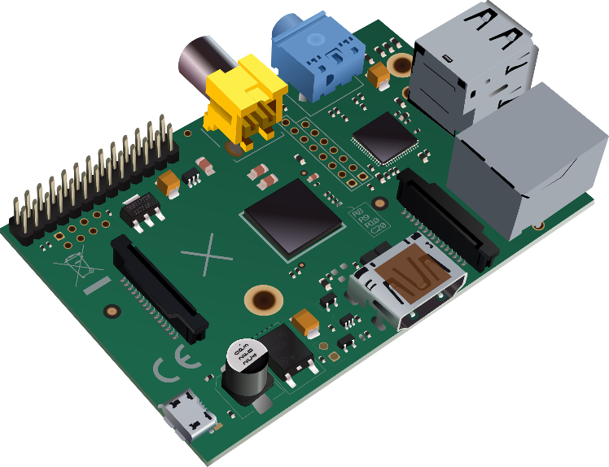


Sound Sensing System​ with Power Over Ethernet Technology​ Samantha Shreck and Zoe Protin​ Advisor: Brian Davison​
Motivation and
Problem Statement
With Lehigh’s rigorous academics, students are often looking for a quiet place to study around campus. Without being in a building or classroom, there is no way to know how noisy it may be. Our application allows students to remotely check classroom noise levels and accurately find a quiet place to study.
System Design
Hardware Design:
Software Design:
Results
Developed a web application that displays sound data in real time
Raspberry Pi 2
Sound Sensor
Ethernet Port with Gigabyte capabilities
LAN
Server
Performance Test
Accurately read sound levels in db | ✓
Developed our own POE technology | ✓
Compiled data in Central Network Server | ✓
Designed a web application to analyze data | ✓
Solution
To develop a non-invasive system that can:
Be powered over Ethernet for easy use
Record data remotely over Ethernet
Compile data into an easily accessible web application for students to use
Be produced both efficiently and at a low cost
User can access web application anywhere
Web Application
+ Hosted using Node.js with TCP protocols (HTTP)
+ Ajax requests for file information (sound levels, etc.)
+ Data analysis of sound levels, etc.
Extracts certain file based on data analysis
<<Processor>>
Central Networking Server
Conclusion
Our system demonstrates the ability to easily collect and monitor sound data in various buildings throughout campus.
Future Work:
Improve sensitivity of microphone
Expand analytics of collected data
Include a motion sensor
+ Receives sound levels using same UDP port
+ Sound levels collected and stored in files hourly created by Central Server
PoE
4
3
2
1
8
7
6
5
Using UDP protocols over Power over Ethernet technology
Pictured is a stripped Ethernet cable showing its 4 twisted pairs
Sound Sensor Hardware Device
+ Collecting and sending sound levels
+ Using a specific UDP port
- Raspberry Pi sending data packets
- Data packets are the sound levels
Only two of four twisted pairs are needed to provide Ethernet, the remaining two can be used to transmit power.
Cables 1, 2, 3, and 6 provide internet
Cables 4, 5, 7, and 8 supply a signal that can be converted into power
Acknowledgements: Ted Bowen
William Haller Liang Cheng

